Slide 1
Ansār Leadership Conference (ALC)
Baitus-Samee Mosque
Houston, TX
January 14 - 15, 2017

Slide 2
Opening Session
Recitation Of Holy Quran – Muhammad Fytahi

Slide 3
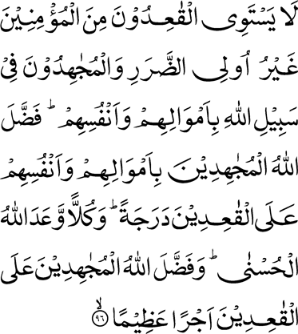
Those of the believers who sit still, excepting the disabled ones, and those who strive in the cause of Allah with their wealth and their persons, are not equal. Allah has exalted in rank those who strive with their wealth and their persons above those who sit still. And to each Allah has promised good. And Allah has exalted those who strive above those who sit still, by a great reward

Slide 4
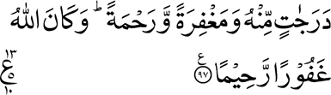
Namely, by degrees of excellence bestowed
by Him, and by special forgiveness and mercy. And Allah is Most Forgiving, Merciful

Slide 5
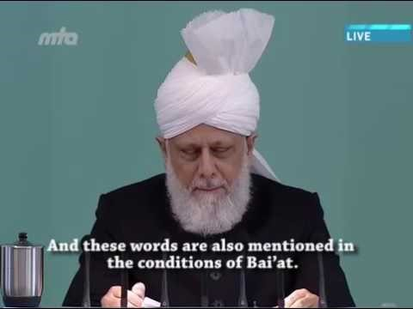
Video

Slide 6
Closing Session
Recitation Of Holy Quran – Ismail Annani

Slide 7
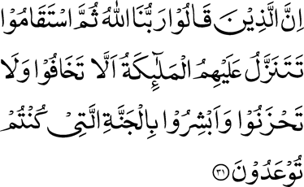
As for those who say, ‘Our Lord is Allah,’ and then remain steadfast, the angels descend on them, saying: ‘Fear ye not, nor grieve; and rejoice in the Garden that you were promised

Slide 8
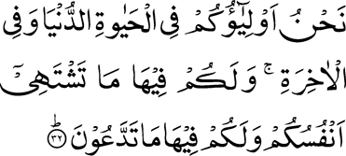
We are your friends in this life and in the Hereafter. Therein you will have all that your souls will desire, and therein you will have all that you will ask for —

Slide 9

An entertainment from the Most Forgiving, the Merciful

Slide 10
Video
https://youtu.be/UbnfbqNjWQw

